Slide 1
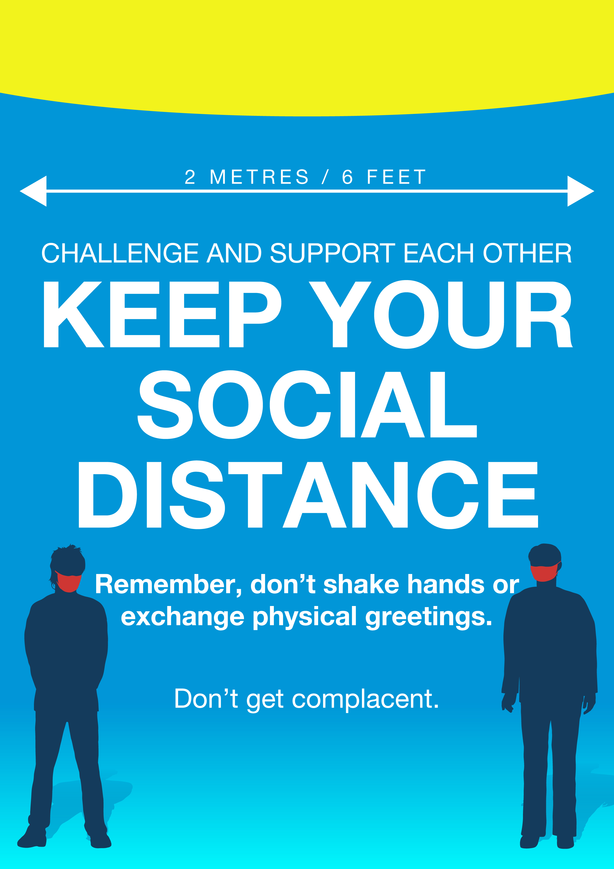
Prison name
Safe for all, at a distance

Slide 2
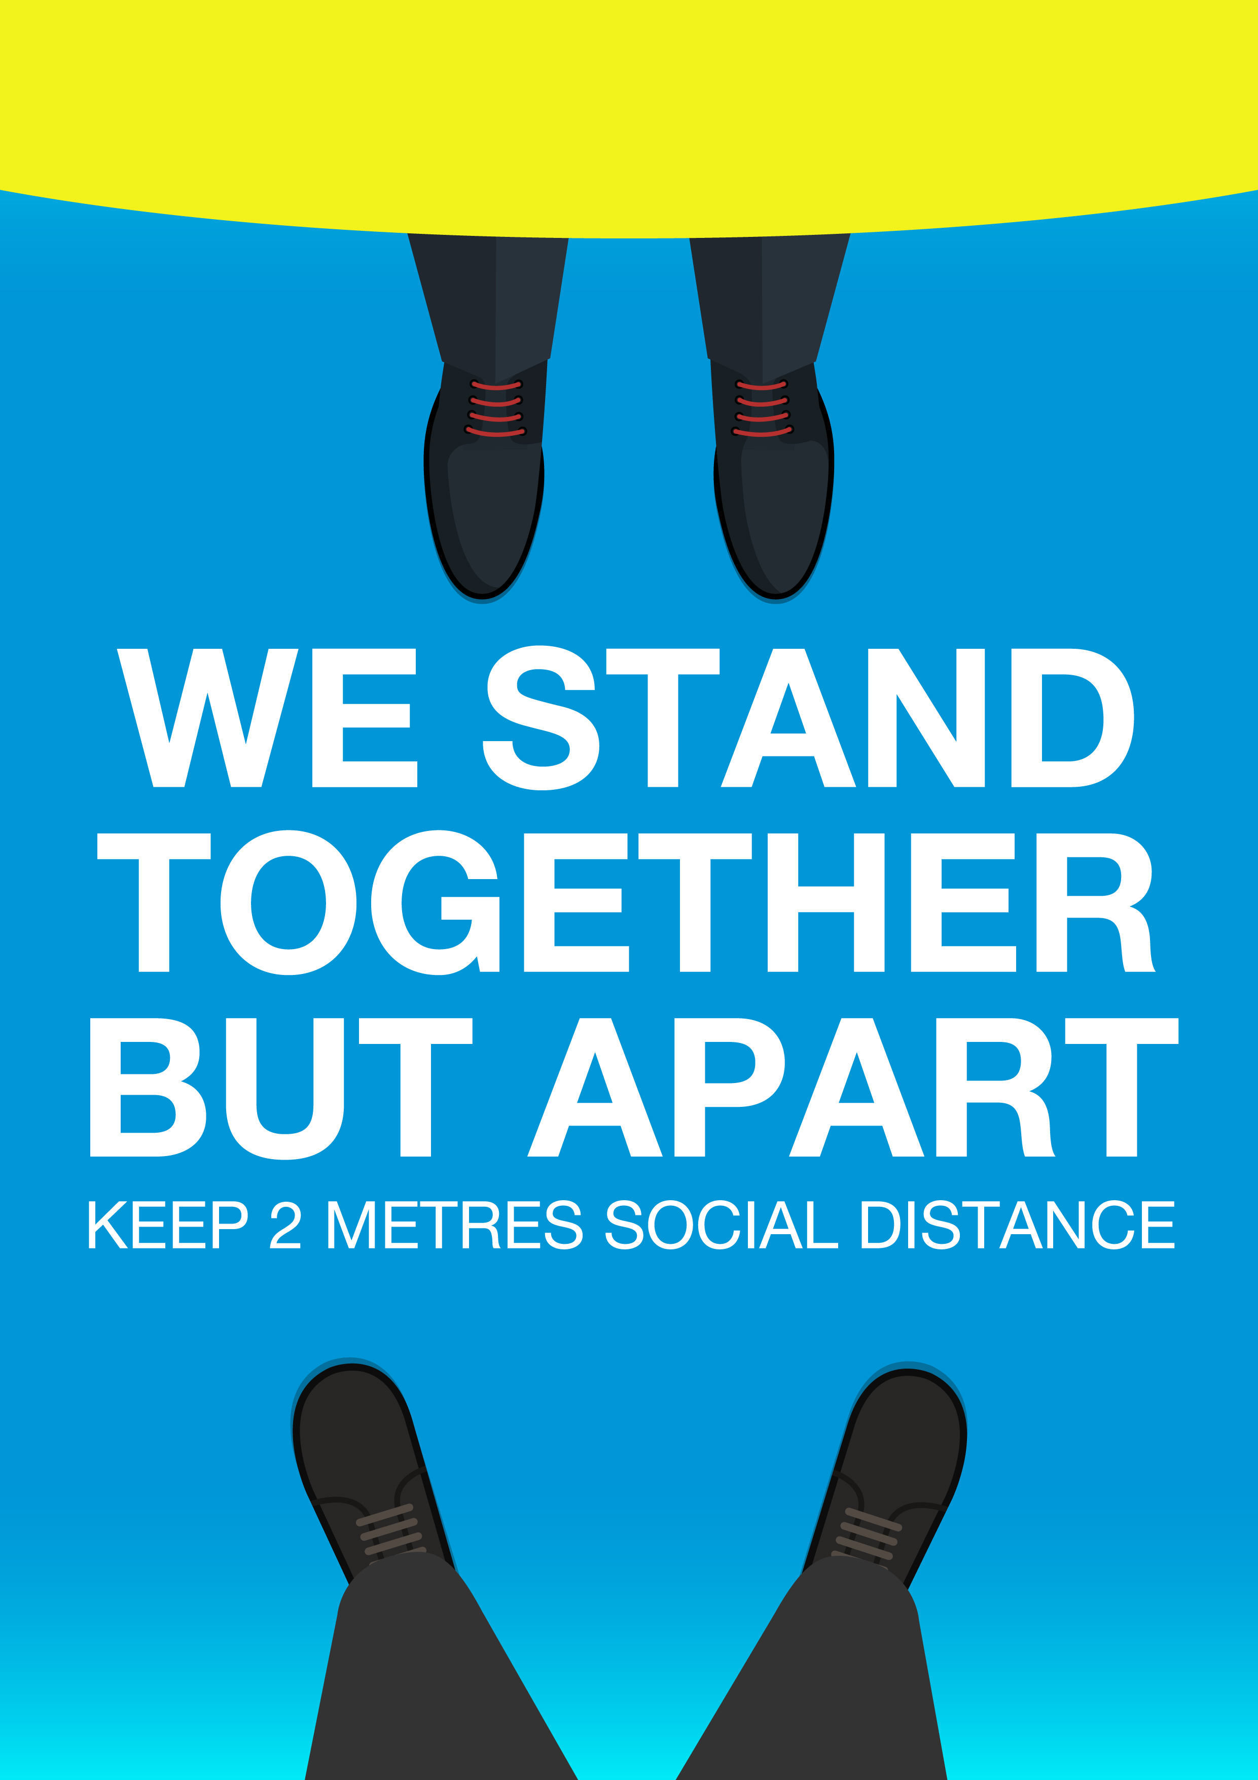
Prison name
Safe for all, at a distance
Prison name
Safe for all, at a distance

Slide 3
Prison name
Safe for all, at a distance
Prison name
Safe for all, at a distance

