Slide 1
COVID-19 in prisons and other prescribed places of detention (PPDs)
Health Protection Teams, PHE London
September 2020

Slide 2
Relevance
Public and privately-managed prisons
Immigration removal centres (IRC)
Children and young people’s secure estate (CYPSE)
young offender institutions (YOI)
Secure training centres (STC)
Secure children’s homes (SCH)
Content accurate at time of presentation but always refer to online guidance for latest information

Slide 3
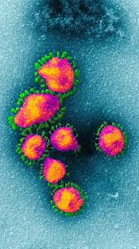
What is a coronavirus?
The name for a family of viruses.
Halo or crown around them – hence coronavirus.
Known about since 1930’s.
Mainly cause lung (respiratory) diseases.
The name of the current coronavirus is SARS-COV-2.
Notes:
Dr June Almedia identified the first human coronavirus in 1964 in St Thomas’s

Slide 4
COVID-19: symptoms
COVID-19 is the name of the DISEASE
It is caused by SARS-COV-2 which is the VIRUS
It causes an infection in the throat (upper respiratory tract) and lungs (lower respiratory tract)
Main symptoms
Fatigue
Muscle pain
Cough
Sore throat
Loss of smell and/or taste
Gastrointestinal
Headache
Fever
Shortness of breath or chest tightness

Slide 5
COVID-19: severity
Mild (Home)
~80%
Moderate (Admission)
~15%
Severe (ITU)
~5%
Severity & mortality increase with age
Source: WHO Coronavirus disease 2019 (COVID-19) situation report – 41
Notes:
80% of general population will experience mild disease
15% would require clinical attention and hospitalisation
5% require hospital admission to Critical Care Unit
Subsequent situation report updates do not include percentages, just say majority of people experience mild symptoms etc. (i.e. situation report 27 April 2020 # 98)

Slide 6
How do you get it?
Direct
Touching
of face
Airborne droplets or infected body fluids
Indirect via surfaces

Slide 7
Infected body fluids
Airborne droplets and aerosol
Blood
Urine & faeces
Tears
All bodily fluids (except sweat) should be regarded as potentially infectious

Slide 8
Infectivity and recovery
Incubation period – time when you are infected but not showing any symptoms: Usually 5-6 days (can be between 1 to 14 days).
Infectious period – time when you can infect others: Usually infectious up to 10 days after onset of symptoms. Further evidence awaited.
Recovery time – time taken to become well again: Mild/moderate cases up to 14 days. Severe cases up to 3-4 weeks.

Slide 9
Challenges for Prisons and Secure Settings

Slide 10
Influencing factors .
People in prison/closed settings are a marginalised and underserved group with significant health needs
Potentially a large ‘vulnerable’ population
Reliant on essential workers being present
An estate at nearly full capacity with cell sharing as routine

Slide 11
Guidance

Slide 12
Key messages for everyone
Hand-washing:
Soap kills and removes the virus and other infectious agents.
Most effective method for preventing spread.
Alcohol gel (>60%) can also be used – must let it dry.
Social distancing – 2 metres:
Prevents coughs/sneezes from reaching others.
Shielding:
Protect those who are extremely vulnerable.
Keeping them in a safe (home) environment.

Slide 13
Your staff
Staff MUST remain off work if: They have symptoms; OR Someone in their home has symptoms.
Staff should stay alert for symptoms
Staff with symptoms must remain off work for 10 days. Must have improved before returning to work. Must have been fever free for the last 48 hours – if not, continue self isolation until fever free for 48 hours.
Staff with someone unwell in their household must remain off work for 14 days: If a staff member develops symptoms during their 14 day isolation they only need to self-isolate for 10 days from onset of symptoms. This may mean they finish before or after the 14 day period.

Slide 14
Symptoms in staff member
COVID negative and no longer symptomatic
Return to work
Yes
If clinically improved and no fever for last 48 hours
Able to Access Testing
Testing
done
COVID negative and still symptomatic
Self-isolate
COVID positive
No
Continue self-isolation for at least 10 days
Notes:
PHE guidance states that if symptomatic must self isolate for 7 days despite negative test

Slide 15
Symptoms in household of member of staff
HH member is COVID negative and staff member is well
Improvement & 10 days after symptoms
onset*
Return to work
Yes
Staff member has no symptoms after 14 days
Household member able to Access Testing
Testing
done
Self-isolate
Staff member develops symptoms whilst isolating
HH member is COVID positive
No
Continue self-isolation for at least 14 days
Notes:
* = must be fever free for at least 48 hours – so from Day 5.

Slide 16
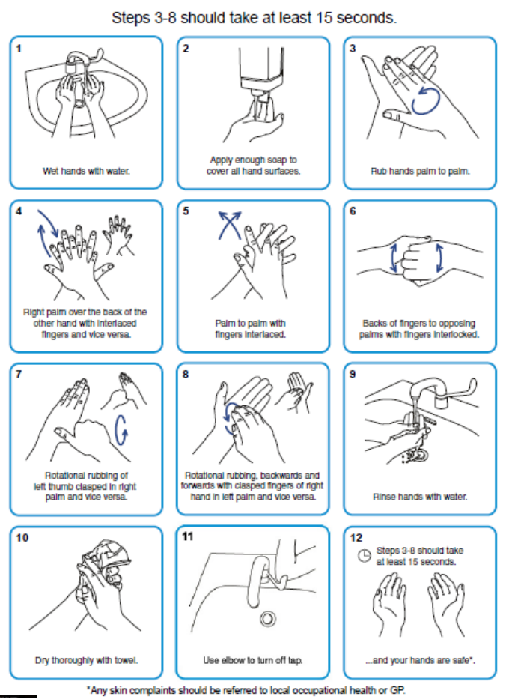
Hand washing
As often as possible for at least 20 seconds:
Ideally soap and warm water.
Alcohol gel otherwise (allow to dry).
Definitely:
Before and after resident contact.
After coughing/sneezing.
Before food preparation.
After toileting.
Correct technique essential
Include wrist and forearm.
Link to online video

Slide 17
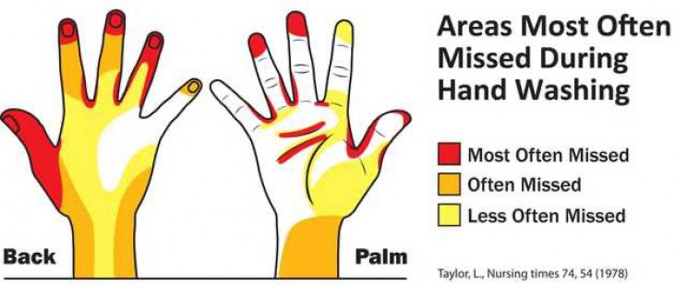
Hand washing: commonly missed areas

Slide 18
Work clothing
Wear your normal work clothes or uniform at work.
Do not wear your uniform when going home every day Refer to HMPPS guidance - transport uniform in a plastic bag and store/wash it safely.
Cleaning work clothes/uniform at home: Should be laundered after every shift separately from other clothes. If not, store separately from other clothes until washed. Use the maximum temperature possible and in a wash cycle of at least 10 minutes. Do not overload machine. A suitable detergent should always be used. Clothes should be ironed or tumble dried after wash.
Notes:
Check HMPPS guidance on uniforms

Slide 19
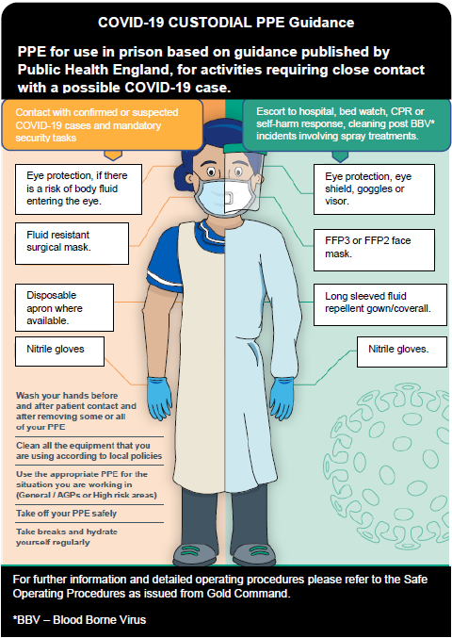
Correct wearing and removal technique is really important.
You must still wash your hands even if using PPE.
Most recent guidance always available on gov.uk website
Putting on (Donning) and removing (Doffing) PPE
Notes:
This will be answered by other work on PPE for previous slide

Slide 20
PPE changing frequency
Plastic apron
Fluid resistant mask
Eye protection
(only if risk of splashing)
Gloves
Up to 4hrs
Change between EACH resident/prisoner
Up to date guidance available online

Slide 21
Common misconceptions with PPE
DON’T remove PPE and then put it back on: E.g coffee break, drinking water, smoking a cigarette, toilet breaks. Remember that those who smoke have poorer outcomes with COVID-19
DON’T hang your mask on your neck or on your head – if the mask is removed from your mouth it must be disposed of and replaced.
DON’T touch your face especially if wearing gloves.
DO wash your hands often.
DO organise your breaks to minimise removal and replacement of PPE: Ensure ALL PPE is removed when you take your break. Make sure you eat and drink enough – wearing PPE can get hot. Ensure you use the toilet during your breaks.
DO remember to take all the equipment you need into each room.

Slide 22
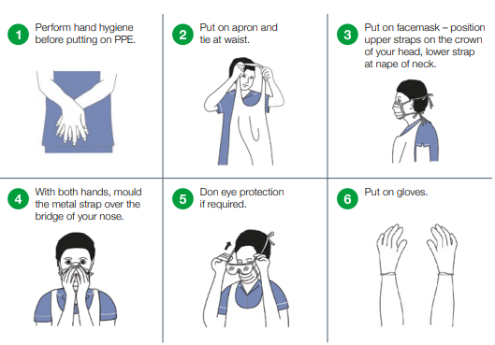
Putting on PPE

Slide 23
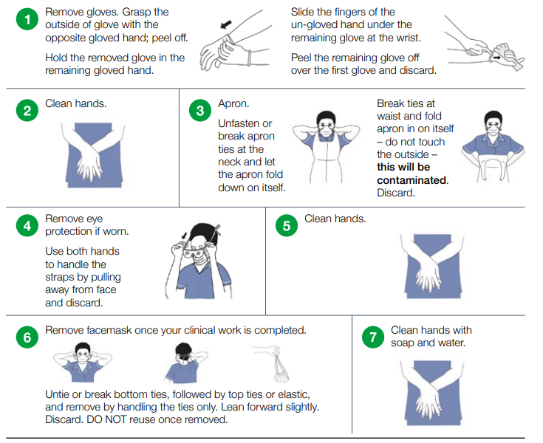
Taking off PPE
Discard used PPE into clinical waste and dispose as per local policy

Slide 24
Admissions to Prison and PPDs and release
Refer to current guidance on isolation, shielding and cohorting in Prison/PPDs and in the community
Prisons & PPDs, communities and hospitals should work together to enable smooth transfer of patients between settings in accordance with current guidance.
Testing is not required prior to admission or release
Results DO NOT need to be available prior to admission.
Management depends on test result, symptoms and days in isolation.

Slide 25
Outbreak management

Slide 26
Identification
Outbreak: 2 symptomatic cases within 14 days of each other.
Main symptoms
Cough
New confusion
Reduced alertness
Influenza like illness
Loss of smell and/or taste
Fatigue / lethargy
Reduced mobility
Diarrhoea
Fever
Atypical symptoms possible in the elderly
and young adults

Slide 27
Outbreak preparedness
Ensure soap, water and paper towels available at each sink.
Alcohol based hand rub available in specific location.
At least >72 hours of PPE available.
Adequate staffing numbers and reserve staff in case of illness.
Staff health and wellbeing is addressed and supported.
Notes:
Oxford Centre for Evidence based medicine recently reviewed all the evidence regarding IPC in care homes.
They found: Effectiveness of infection control measures is dependent upon a number of factors and a combination of strategies with the most significant being:
– Hand hygiene – Access to hand hygiene facilities at the workspace, in addition to use of four or more of the WHO multi-modal strategy generally improve adherence to hand hygiene measures
– Environmental decontamination – Daily cleaning of most touched surfaces and weekly deep clean
– Staff rotation – Allocating staff to one facility consistently may reduce spread across several locations
– Visitors – Restricting visitation to only emergency/critical cases
– Testing – Creates rapid response in placing added measures to contain and prevent further spread

Slide 28
Cleaning
Declutter rooms and communal areas: Reduces number surfaces exposed to any potential infection. Allows all surfaces to be cleaned effectively. Safer in terms of trip hazards.
For any cleaning agent ensure it is appropriately prepared and applied (contact time) following manufacturers instructions. Cloths and mop heads should be disposed of after a single use. Ensure cleaning items are disposed of safely.
Increase frequency of general cleaning paying particular attention to: High touch surfaces (door handles, light switches etc…). Equipment used between prisoners.
Full guidance and instructions available online including exact procedures (Annex G)

Slide 29
Isolation & cohorting if symptoms
Symptomatic prisoners must be isolated for at least 10 days from onset of symptoms and 48hr fever-free.
Ideally this should be in single cell accommodation
Where singe cell is not available, there should be heightened monitoring for the concerned individual and their cellmate.
Staff should ideally be cohorted to wings with either confirmed, symptomatic or asymptomatic prisoners (e.g. shielding) .
Appropriate PPE must be worn for ALL resident encounters/care.

Slide 30
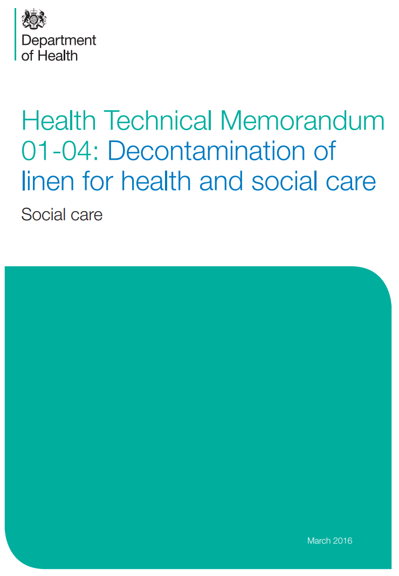
Linens, laundry & waste
Linen should be handled in accordance with the Health Technical Memorandum 01-04 (2016).
In summary: Potentially infected linen should be handled with appropriate PPE. Linen should be packaged in the prisoners room in an appropriate bag. If required, linen should be sorted before bagging/transport. Linen must be transported in a safe manner. Linen must be washed and prepared in an appropriate manner.
3 categories of waste:
Black = domestic
Yellow/black stripe =offensive
Orange = infectious

Slide 31
Communicate with prisoners and families
Continue doing what you do in the best way you can. Many people depend and rely on you in their lives.
There is lots of fear and anxiety in the prison community – be prepared:
Be knowledgeable
Understand the basics of the virus and controlling infection.
Support your prisoners and their families:
Reassure where necessary using your experience and knowledge.
Escalate and seek medical advice where necessary:
There is a pandemic but normal care is also continuing.
Help your prisoners stay in contact with family and friends.
Notes:
Change to communication and simone to review wording

Slide 32
Look after yourself: health & wellbeing
You're doing the best for your prisoners, but don’t forget to do the best for yourself too.
Providing care is emotionally rewarding but can be tough – the current situation has amplified that.
Support is available for you: SHOUT free text message service – text FRONTLINE to 85258 PHE Mental health and wellbeing during COVID-19 NHS Every Mind Matters website Samaritans and NHS – confidential support line for NHS workers in England
The range of support packages is being constantly expanded – keep an eye out online.
Notes:
Ask Sam to check specific services available

Slide 33
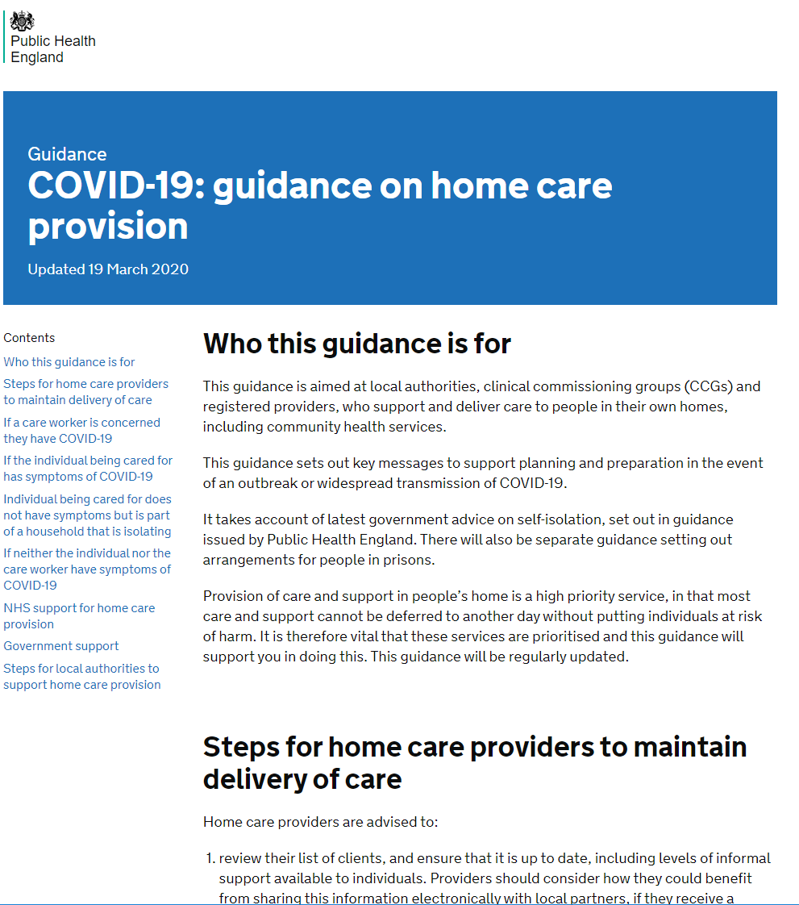
Where to find extra help
Ensure you have read relevant guidance on the gov.uk/coronavirus website
Speak to your line manager or senior for more advice
HMPPS Employee Assistance Programme:
call the support line free on 0800 019 8988 (It is open 24 hours a day, 7 days a week.
visit the website www.pamassist.co.uk – Username: HMPPS, Password: HMPPS1
download the PAM Life app to your smartphone or mobile device to help you make positive lifestyle changes
Notes:
Ask HMPPS colleagues
HM

Slide 34
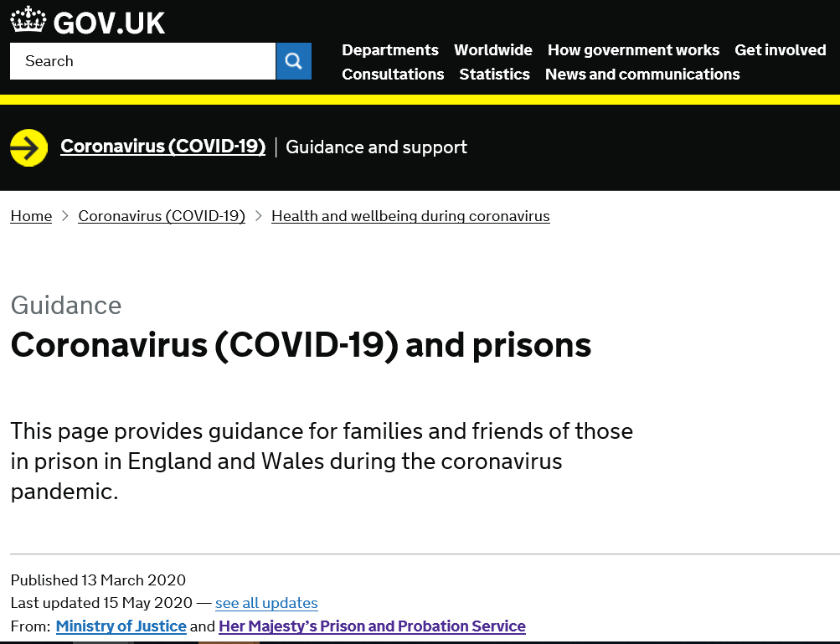
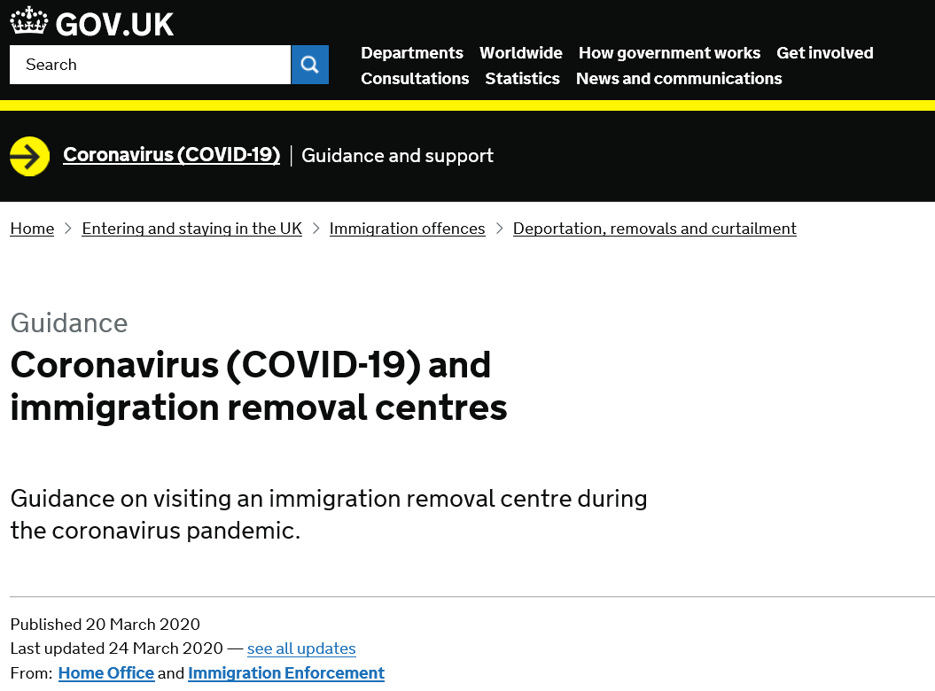
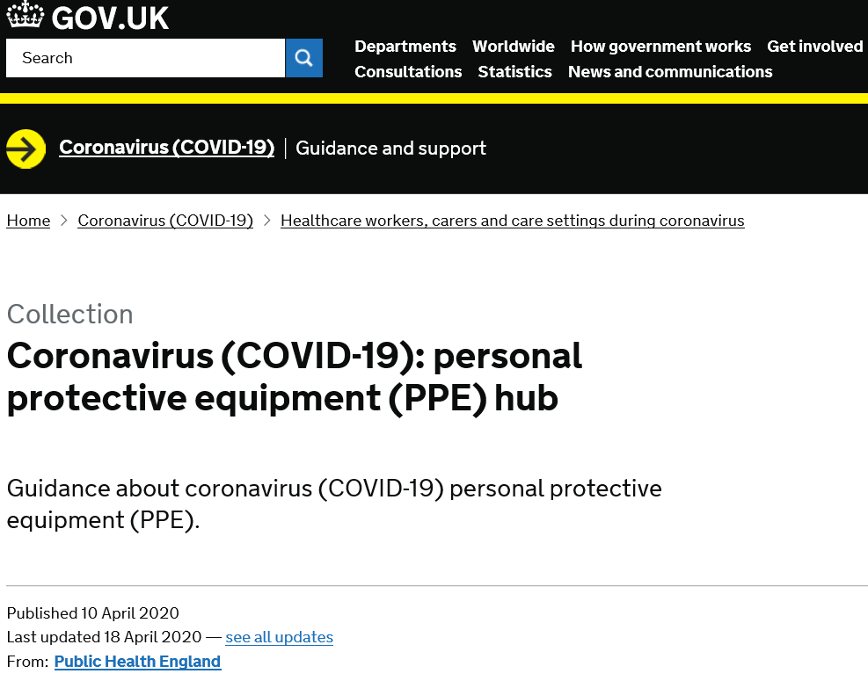
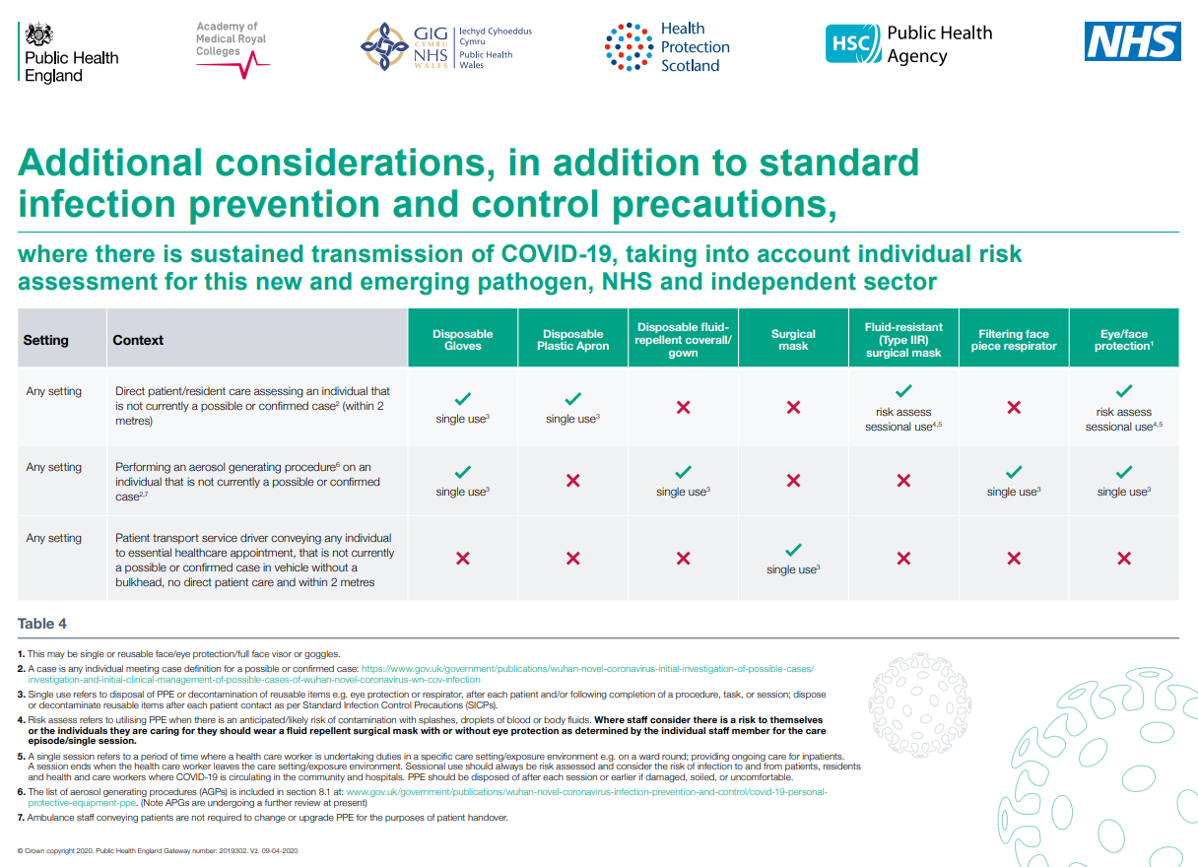
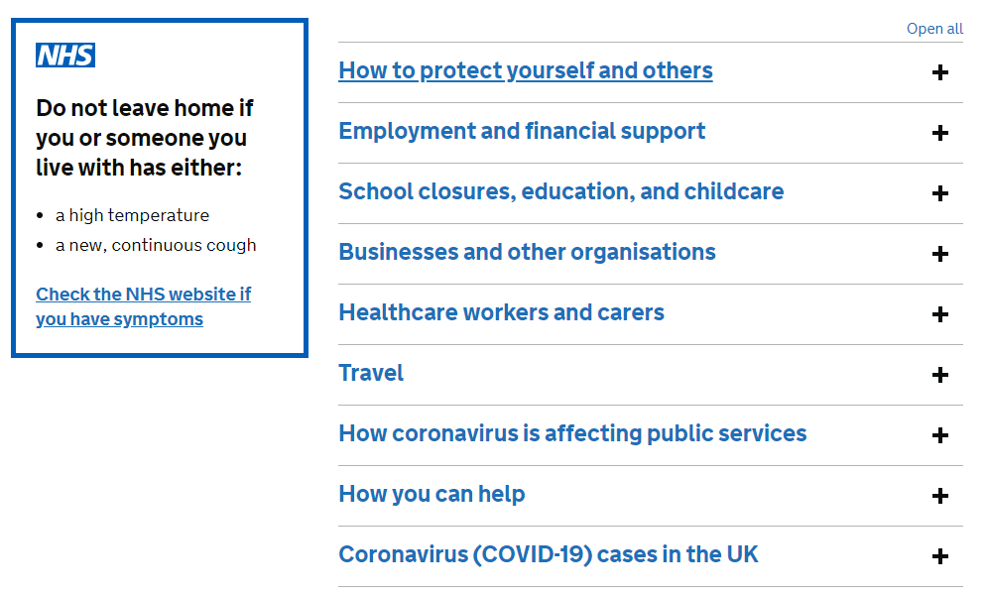
Link to resources
Covid19 & Prisons
COVID-19: prisons and other prescribed places of detention guidance
COVID19 & Immigration Removal Centres
COVID-19: personal protective equipment (PPE) hub
PPE for sustained transmission
Gov.uk coronavirus portal
Notes:
Check additional PPD guidance and signpost to HMPPS guidance
Check with HMPPS for guidance

Slide 35
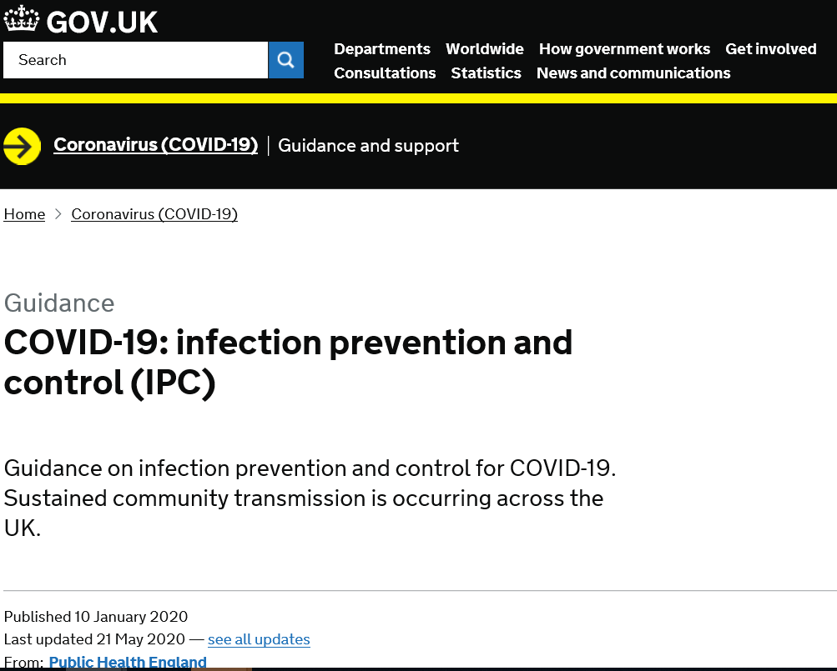
Link to resources
COVID-19: infection prevention and control (IPC)
COVID resource pages on the HMPPS intranet: https://intranet.noms.gsi.gov.uk/covid-19-coronavirus
Notes:
Check additional PPD guidance and signpost to HMPPS guidance
Check with HMPPS for guidance

Slide 36
Acknowledgements
Thank you to all staff supporting people in prisons. We hope this has been helpful.
With grateful thanks for sharing and contributing to content:
Youssof Oskrochi Bharat Patel
Karen Hawker Sarah Lang
Rebecca Cordery Christine Murphy
Karen Bernard Ann Lusmore
Viv Cleary Fiona Coogan
Gopal Rao Rachel Flowers
Sterling Rippy Laura Maclehose
Ellen Schwartz Deborah Turbitt
Laura D’Cruz Rachel Thorn Heathcock
Anjana Roy Lipi Begum
Dianne James Rachel Campbell
All staff working in the London Health Protection Teams and our colleagues in Health and Justice and HMPPS
Icons from the thenounproject used under license by PHE London.

