Slide 1
Creating a Rehabilitative Culture

Slide 2
Long term cultural change
Meaningful cultural change is a long term process.
It is difficult and requires hard questions to be asked.
Commitment and consistency are required to maintain progress.
Momentum is built up by approaching the issue “Staff member by staff member. Wing by wing. Prison by prison”.

Slide 3
First Impressions make a big difference
The initial reception experience should be both positive and professional.
First night centres/induction units reflect the way you will be treated in an establishment .
The entrance and waiting area for domestic visitors is important.
Improvements in visits and the visits experience are always worth while.
Being treated as an individual with decency and respect from reception to discharge makes an enormous difference.

Slide 4
Procedural Justice (or fairness of process)
Procedural justice suggests that the fairness of processes in justice systems affects how people view the system and respond to it.
Four principles of procedural justice:
VOICE
Being able to tell their side of the story and this being sincerely considered by the authority figure
NEUTRALITY
Transparent and open use of rules, neutral and principled decision making
RESPECT
Taking issues seriously, being courteous and polite, respecting rights and being respectful in treatment
TRUST
Sincere, caring, open, honest, considering views, doing what is right for everyone, lack of prejudice
Why is this useful to know about?
Procedural justice helps people accept and abide by decisions:
increases how legitimate the law and decisions made by those in authority are seen to be
creates commitment to obey (immediately and over time)
Procedural justice positively affects perceptions:
more positive views of the law, system, authority figures
increases trust and confidence in authority
How people and their problems are managed (e.g. in court) influences these outcomes more than the final decision made (i.e. whether this is in their favour or not).
Procedural justice matters whether stakes are high or low.

Slide 5
Rehabilitative Adjudications
Procedurally just treatment (voice, neutrality, respect, trustworthy motives)
Adjudications that are perceived to be more legitimate, facilitate compliance and offer a better chance for learning and change
Better outcomes for our staff and the people in our care
Rehabilitative skills and focus during adjudications
Done within the context of traditional adjudications (same PSI, paperwork, decision-making and sanction allocation)

Slide 6
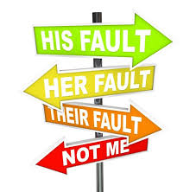
Tackling poor behaviours
Address those who do not share values or respect community rules.
This applies to both those who live in and those who work in prisons.
Recognise and reward those we embody the right behaviours.

Slide 7
If we want to change someone’s behaviour…..
Punishment only works when specific conditions are met, and we meet these very rarely.
Punishment can result in short-term compliance, but not internalisation of values.
Evidence points to a range of unintended outcomes arising from punishment.
Evidence shows that reward and reinforcement produce robust gains in a variety of desired behaviours.
Reward teaches a person what to do.
Interventions such as conflict resolution training and cognitive skills training have been found to be effective in changing behaviour (e.g. violence).
Most successful approaches teach skills and use active, participatory methods.

Slide 8
Using Praise and Reinforcement
Reward (especially verbal reward) is more effective than punishment as a strategy to change someone’s behaviour for the long term. Praise and reinforcement help a person know what behaviours are valued, and motivates people to repeat positive behaviours.

Slide 9
Rehabilitative skills
Eight Rehabilitative Skills
Socratic Questions
Actively Listening
Using praise and reinforcement
Collaboration and transparency
Respectful tone
Giving choices and hope
Warmth and humour
Statements of empathy

Slide 10
81% of what contributes to the quality of a prisoners life is prison officers
Interpersonally courteous
Rehabilitative
Use
legitimate authority
Resilient
Morally conscious

Slide 11
Maxims that Matter
1. People matter more than performance.
2. Principles matter more than popularity or politics.
3. Presence (and engagement) matters more than policy.
4. People do what is rewarded.

Slide 12
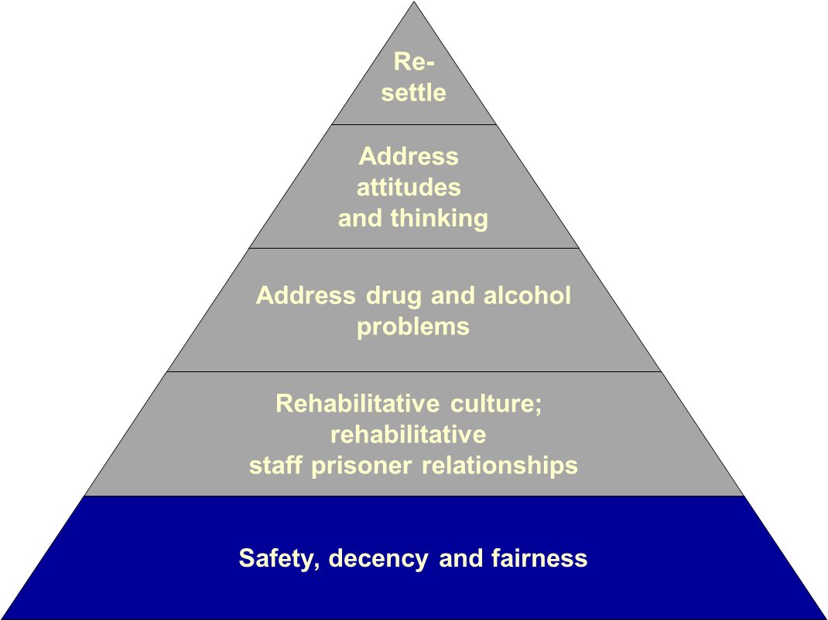
Safety, decency and fairness
Decency:
Staff treat people in their care with respect
Prison environments are clean and decent
Sufficient social interaction, food, clothing, family contact, fresh air and the chance to engage with purposeful activity.is provided

Slide 13
Creating a Rehabilitative Culture
Relationships
Staff have coaching/ FMI skills
People are able to take decisions & manage their lives
Gives Hope
Staff believe people can change
Fair processes
People believe they have a future, & are assisted to plan for how it will be better
Everyone helped to find their strengths & talents
People address & treat each other respectfully
Decisions always explained
Stress-reducing physical environment
Encourages identity change
Builds social capital
Access to green and nature
Clean and decent
Peer mentor and peer support schemes (Do Good Be Good)
Reward new behaviours
Easy for people to contact and to be contacted by family & friends
Fair & transparent processes
Variety of colour & visual interest
“Good dark” & quiet at night
Encourage participation in rehabilitation activities
Rehabilitative
Leadership
Leaders consistently model and encourage rehabilitative behaviours and attitudes
Staff are treated with fair processes
Procedurally just comms
Voice
Staff have legitimate authority
Reward new behaviours more than punishing wrongdoing
Coach in perspective taking & problem-solving
Busy with meaningful activity
Kindness & caring
Clear Vision, Values
& Expectations

Slide 14
How is this achieved?
Rehabilitative Culture: All aspects of our culture are safe, decent, hopeful and optimistic about stopping offending. This is achieved by:
Relationships that are supportive and collaborative for all | Five Minute Intervention (FMI), Strategy of choices, conditions of Success, families work, Key workers
Management and leadership that encourage engagement | Coaching, Councils & Committees, Communications
Activities that promote wellbeing and desistance | Offending behaviour programmes, substance misuse services, education, work, leisure, peer support
Fair processes and system that focus on rehabilitation | Reward and recognition, fair and transparent processes, procedural justice
A normalised environment that promotes safety, decency and hope | Access to outdoors, clean and decent, broken things get fixed, signs and symbols, language
Notes:
The areas we’ve highlighted (so far) and some examples of things sites are doing. Link back to rehab areas and so for example thinking about how processes can support or hinder things like attitudes, how we use our time, how finances are managed.
Also, important to remember that these areas are also relevant for staff as well as those in our care. So how is staff sickness managed, what are staff facilities like, how is staff wellbeing supported. For many sites the focus needs to be on staff first if we are to be able to generate hope. This is a legitimate step in developing rehabilitative culture if we want staff to feel genuinely hopeful, to model appropriate relationships and behaviour and support others in feeling hopeful about changing their lives.
Everywhere is doing something and everywhere has places that could be developed to be more rehabilitative. We probably can’t do everything at once so it could be for places to select what is most important for them and start there.
Activities are part of this. There is a lot of evidence around accredited interventions for example. A rehabilitative culture supports these being successful, it is not instead of these.

Slide 15
Physical Environment & Decency
Interiors
Create interesting and varied interiors with differing views and communal spaces
Put inspirational quotes on walls
Remove negative messages or posters and replace with positive rehabilitative ones
Create reflective spaces
Light/Dark
Maximise natural light during the day and “good dark” at night to aid sleep
Test how cells can be protected from light at night
Create a physical environment which supports a rehabilitative culture and has a positive effect on morale and productivity
Views
Where possible maximise views of open natural green landscapes
Use artwork to provide convincing artificial views
Create large murals e.g. whole walls
Colours
Avoid institutional colours
Use therapeutic colour schemes (cool colours such as greens, blues, purples)
Uses a variety of colours on walls
Colour-code your houseblocks/wings which could contribute to way-finding and orientation

Slide 16
Changing the Culture
You cannot change everyone, you can only create an environment that makes change possible.
M.Whitelaw HMP Swaleside

